Slide 1

GAMECO Marketing Budget 2017
By Ivonne Aspilcueta

Slide 2
Objective
Review and show if sales by Region have stayed the same over time.
Marketing Budget will be decided based on the sales of 2016 by Region.
Review and show which Genre by region can maximize return on investment.
Review and show budget suggestion for 2017.

Slide 3
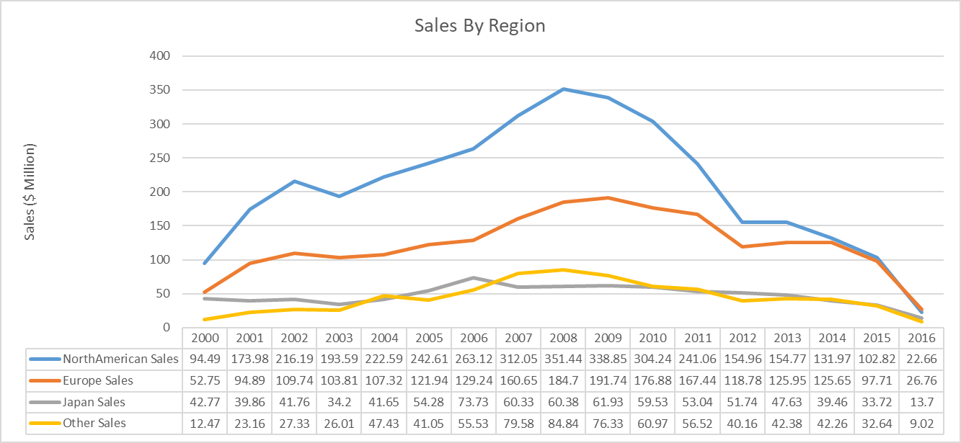
Sales By Region (2000-2016)
Sales By Region has decreased over the time for the last 5 years.

Slide 4
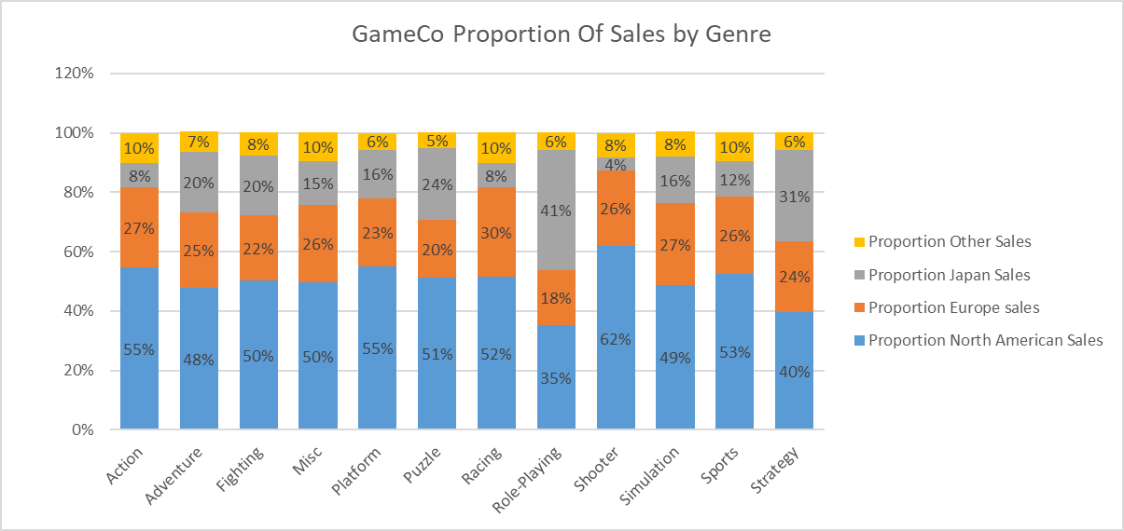
GAMECO Proportion Of Sales By Genre (2010-2016)
In the previous slide we discover that sales has been decrease. We can see here the North American has the top of the sales for games comparing to the other regions.

Slide 5
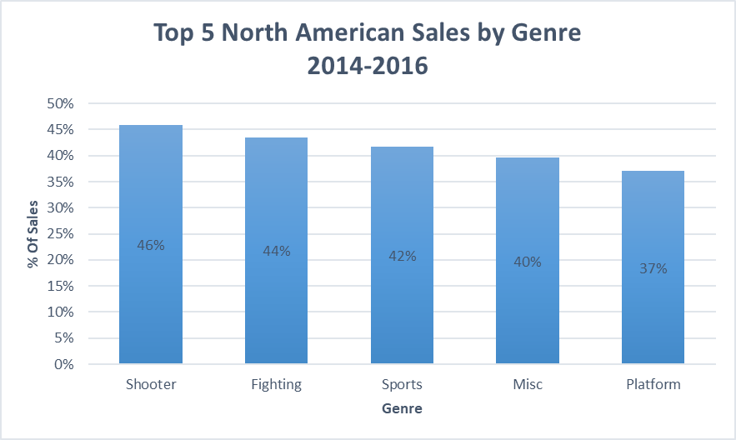
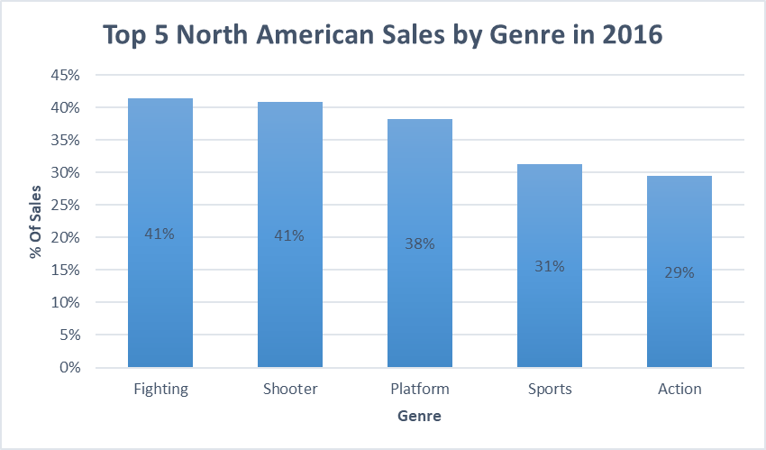
Top 5 North American Sales By Genre
North American Sales are very stable on sales for 2 top categories: Shooter games and Fighting Games.

Slide 6
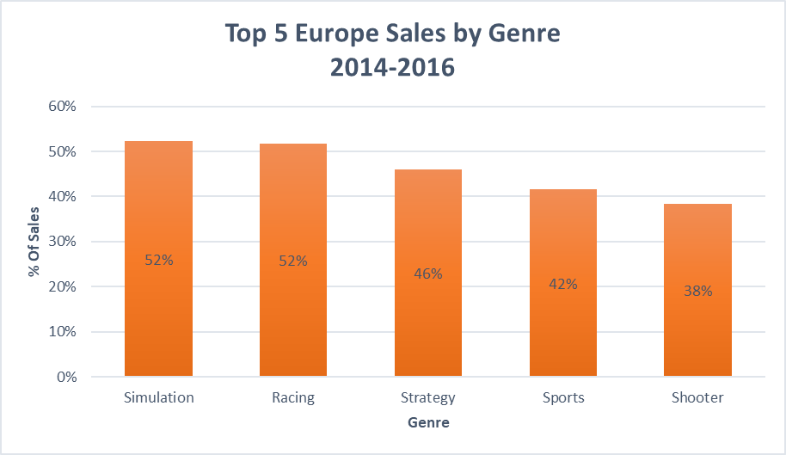
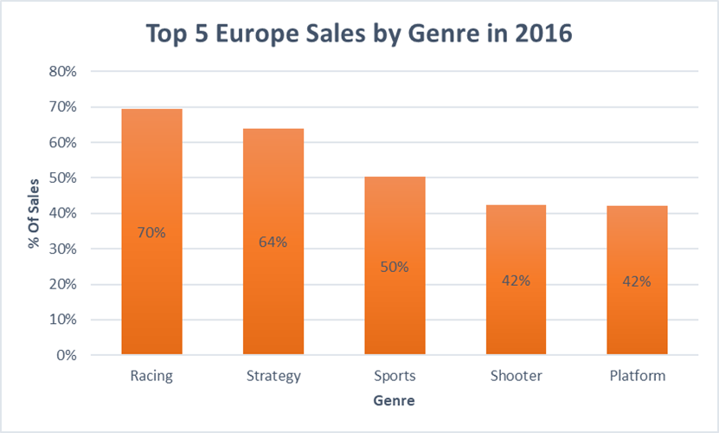
Top 5 Europe Sales By Genre
Europe Sales has a tendency of increasing their sales when a Big event happens. We can see that Simulation games and racing games are the top 2 sales. In 2016 the 70% of sales was for racing games and that’s probably because major racing events happened in that year like the GT World Challenge Europe Endurance.

Slide 7
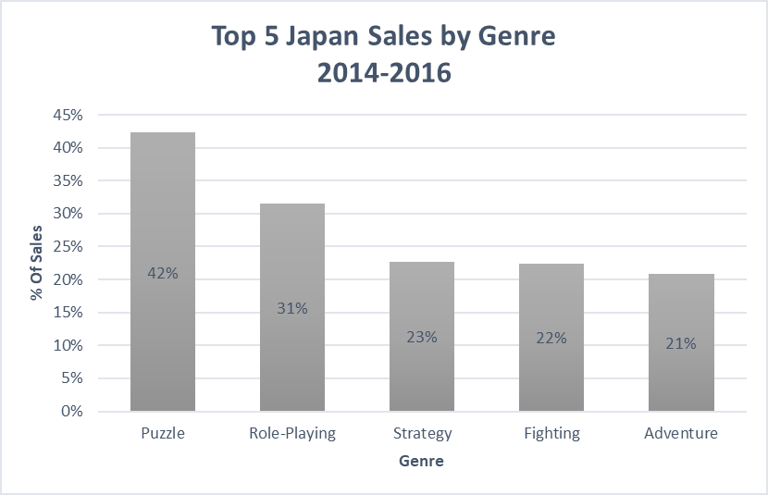
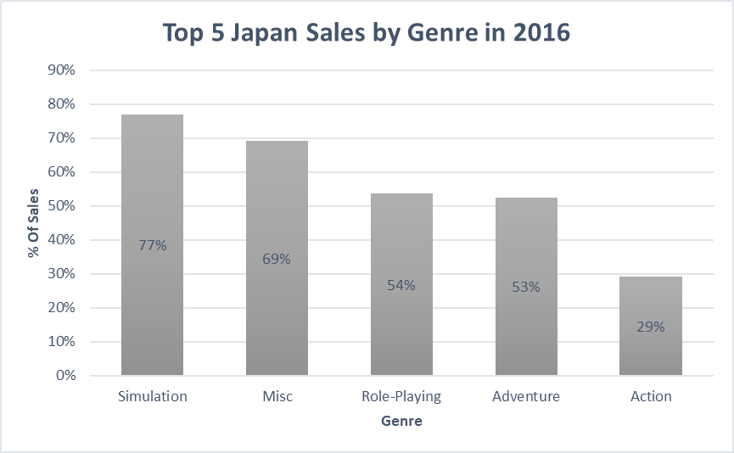
Top 5 Japan Sales By Genre
Japan as Europe has the same tendency, if we observe the sales for 2016 comparing to the previous years (2014-2015) it has the most sales for video games, also in 2016 in Tokyo there was a major event The Tokyo Game Show 2016.

Slide 8
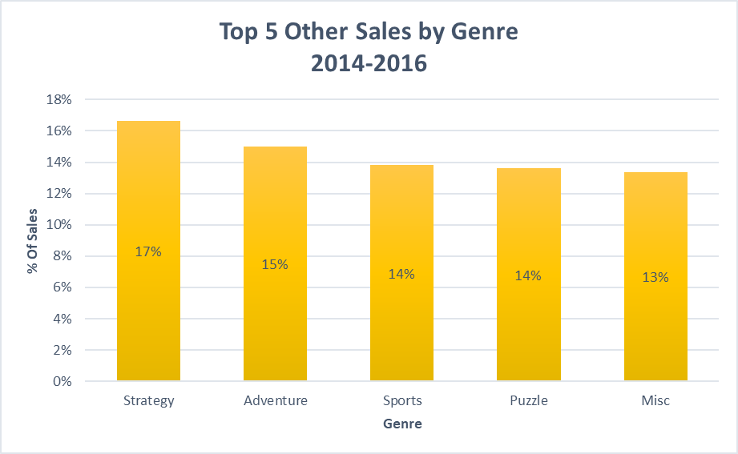
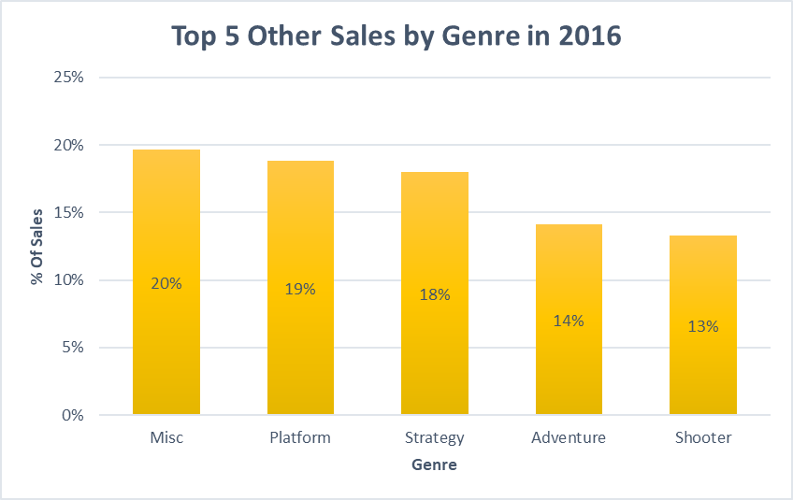
Top 5 Other Sales By Genre
For Other Regions we can observe an increase of sale in 2016 comparing with the previous years 2014 and 2015. As per 2016 the top one game was Miscellaneous games.

Slide 9
Recommendations
In conclusion we can say all game sales are declining for all regions in the past 3 years. However, North American is the number one on sales with the most sells which falls into two categories: Fighting Games and Shooter games, to bring higher sales numbers for this region, conduct a market research to find out why consumers stop buying games comparing to previous years.
Europe and Japan have the same behavior on regards to sales increases, they are determined by Big events = Consumers. Use Budget to increase advertising when Big events happens in 2017 for both regions, Make deals with events sponsors; if not, follow the top 5 genre to conduct a market research to develop more games and platforms for those genre.
Consider to use part of the budget to increase the budget for Other regions. In 2016 the top genre was miscellaneous that means the consumers for that region enjoy a variety of games that does not necessary fall into specific genre, perhaps they go by the most popular game in that moment. A market research is highly suggested here.

